Slide 1
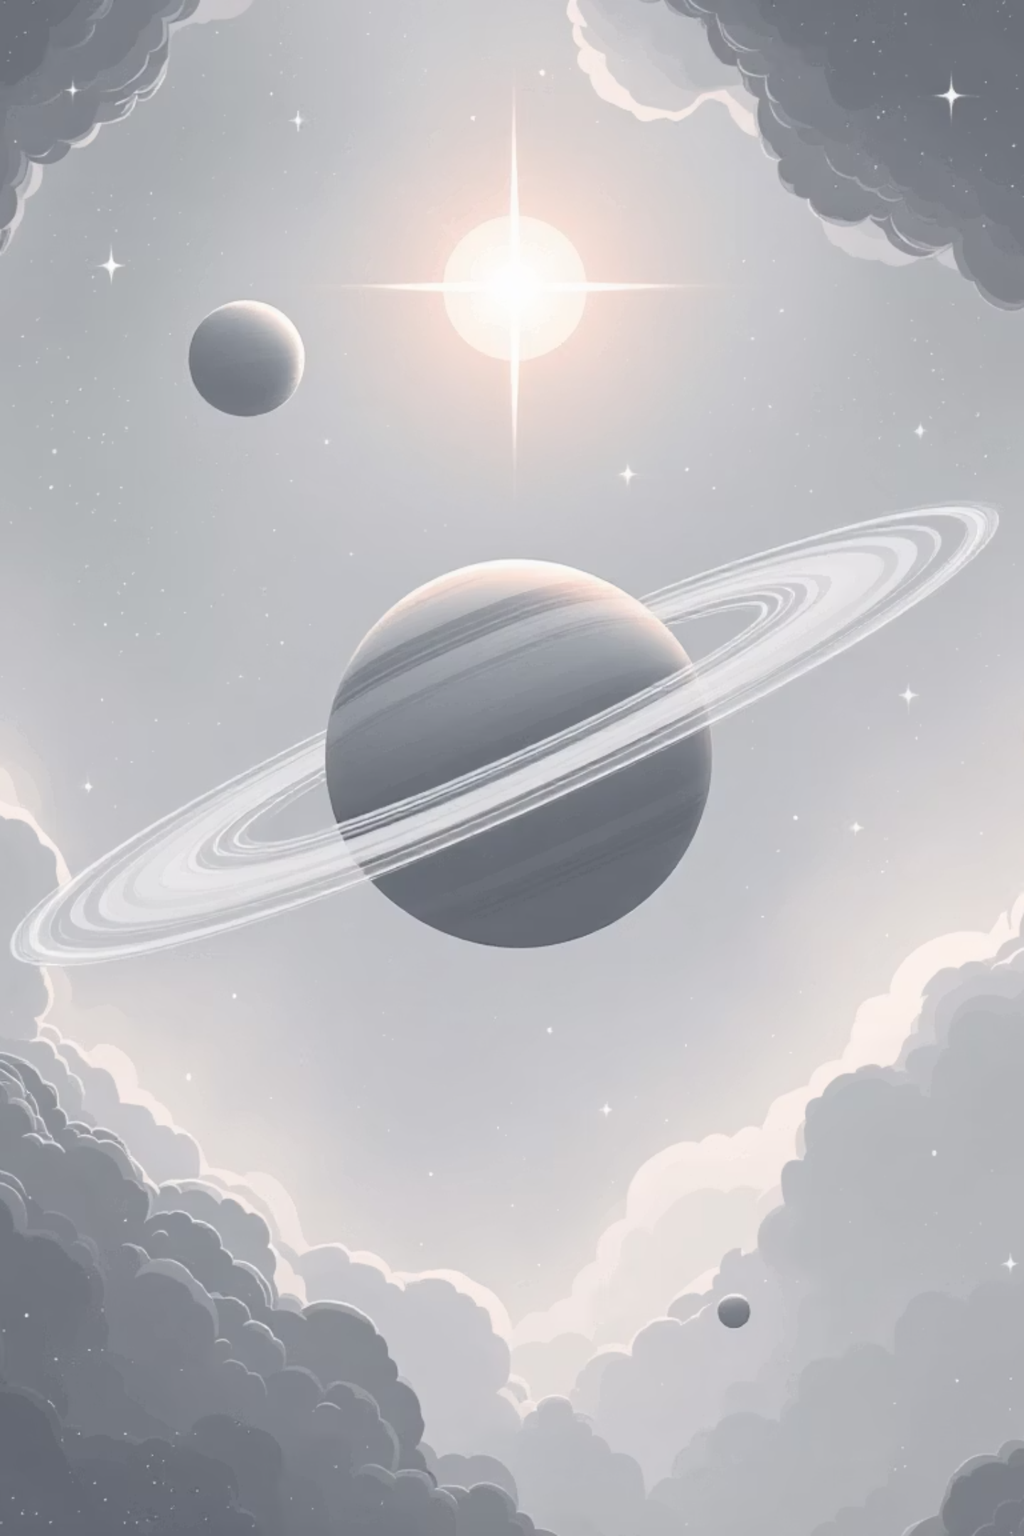
Exoplanet Mass Predictor
Arikrishna Praveen S

Slide 2
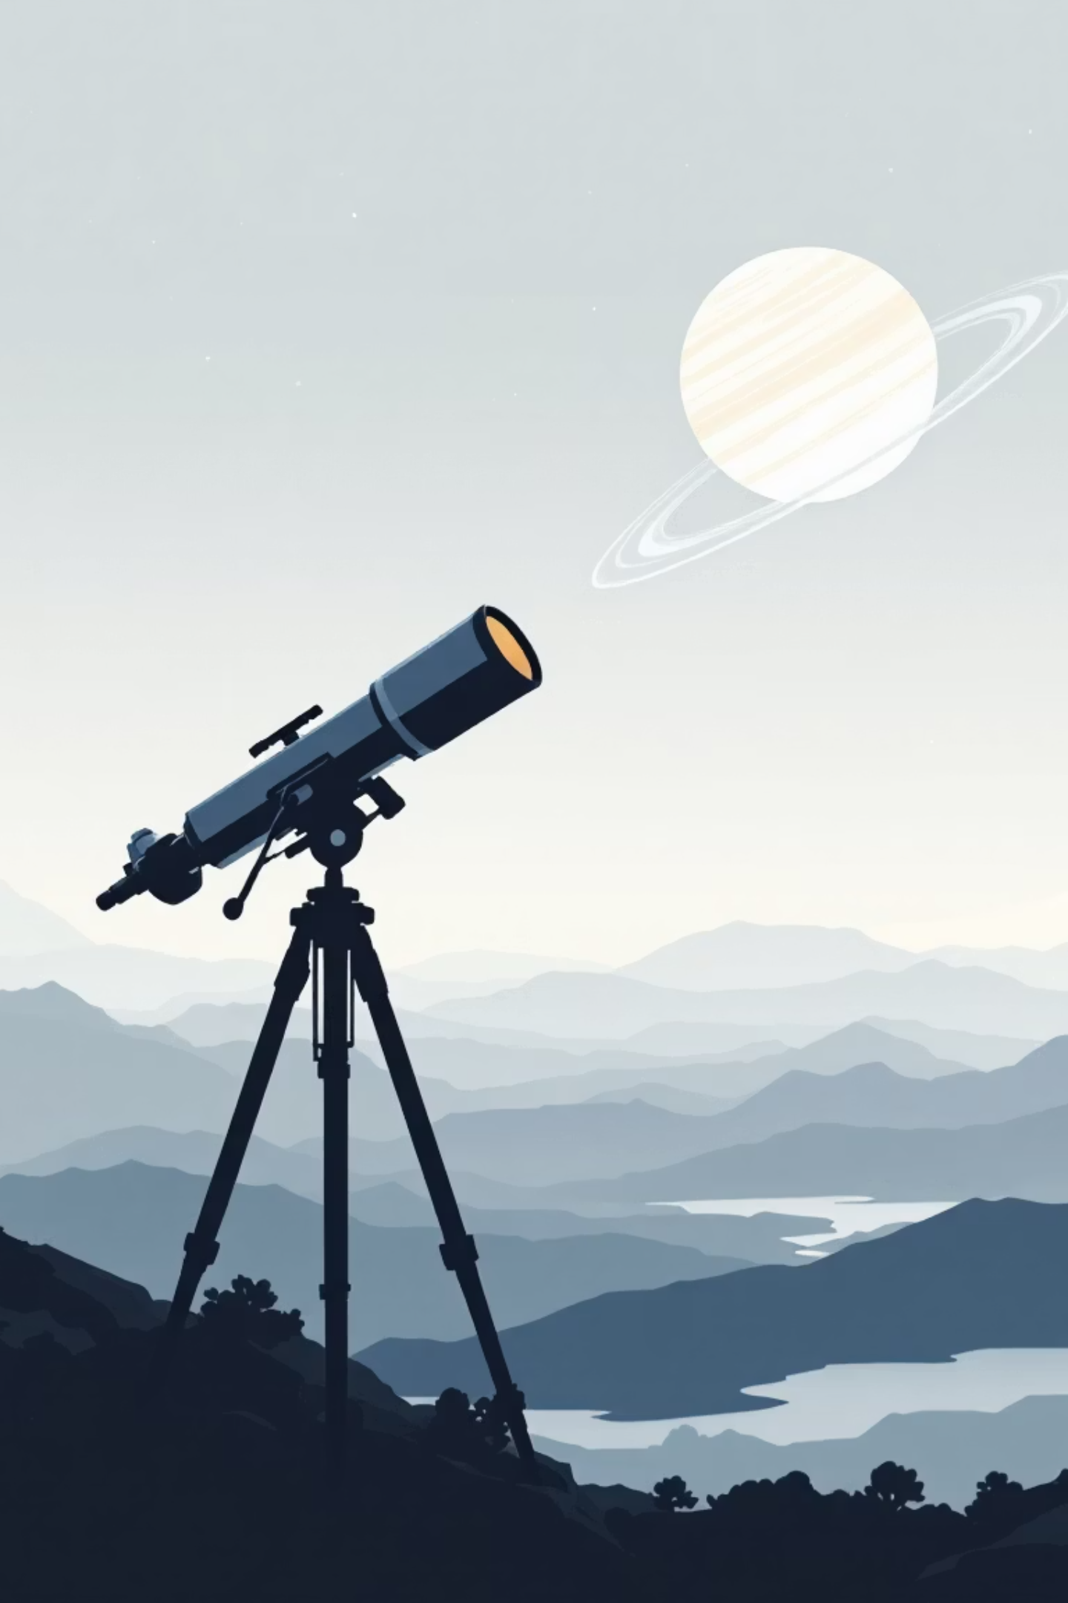






How Do We Measure Exoplanet Mass?
Radial Velocity Method
Transit Method
Detects the subtle wobble of a star caused by the gravitational tug of its orbiting planet. The star's motion toward and away from us creates measurable shifts in its light spectrum.
Measures a planet's size by detecting the tiny dip in starlight as the planet crosses in front of its host star, like a miniature eclipse.
Combined Power
Together, these methods reveal both mass and radius, enabling astronomers to calculate density and determine planetary composition—rocky, gaseous, or something in between.

Slide 3
Step-by-Step Mass Calculation from Radial Velocity
Measuring an exoplanet's mass requires careful observations and mathematical precision. Here's how astronomers transform stellar wobbles into planetary masses:
01
02
03
Determine Host Star Mass
Measure Velocity Amplitude
Calculate Orbital Period
Analyze the star's spectral type and characteristics to calculate M*, the stellar mass in solar units.
Extract V*, the star's velocity amplitude, from the radial velocity curve showing the star's motion over time.
Determine P, the time it takes for the planet to complete one orbit around its star, measured in years.
04
05
Find Semi-Major Axis
Apply the Mass Formula
Use Newton's form of Kepler's Third Law to calculate a, the average distance between planet and star.
Use the equation to calculate planet mass in solar masses, then convert to Jupiter and Earth masses for context.

Slide 4

Case Study: Kepler-78b — Earth's Rocky Cousin
A Breakthrough in Precision
Kepler-78b represents a milestone in exoplanet characterization—a world whose mass and radius we know with remarkable accuracy.
1.2×
1.7×
Earth Radius
Earth Mass
Similar size to our home planet
Slightly more massive than Earth
8.5
Hour Orbit
Incredibly close to its star
Its density matches Earth's, confirming a rocky composition. Mass was measured via radial velocity while size came from transit depth. Though far too hot for life, Kepler-78b proved we can precisely characterize small, rocky worlds across the galaxy.

Slide 5
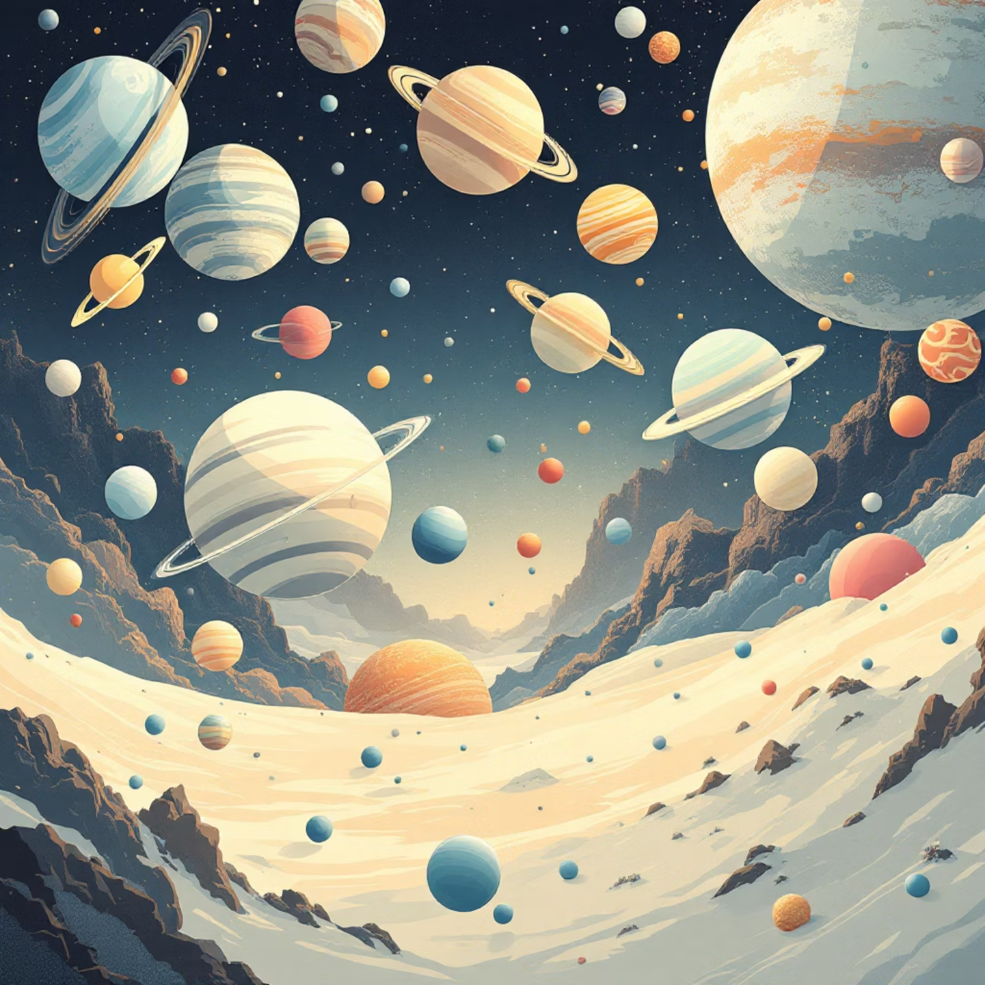
Forecasting Masses for Thousands of Exoplanets
From Size to Mass: Statistical Power
Transit surveys like Kepler have discovered thousands of exoplanet candidates, measuring their sizes but not their masses. Statistical models bridge this gap.
The Forecaster framework, developed by Chen and Kipping, uses machine learning to predict planetary masses from radius measurements, complete with uncertainty estimates. This probabilistic approach reveals unexpected patterns in exoplanet populations.
These mass predictions enable scientists to classify planets into distinct categories—super-Earths, mini-Neptunes, gas giants—and understand the diversity of planetary systems throughout our galaxy.

Slide 6

The Future of Exoplanet Mass Prediction
Classical Physics
Precise Observations
Newton's laws and Kepler's equations remain foundational to all mass measurements
Next-generation telescopes will detect smaller wobbles and fainter transits
AI-Driven Models
Habitable Worlds
Machine learning accelerates analysis and reveals hidden patterns in data
Characterizing masses helps identify potentially habitable Earth-like planets
We stand at the threshold of discovering Earth-like worlds with known masses, composition, and potential for life—unlocking the mysteries of planets beyond our solar system, one mass measurement at a time.

Slide 7
Thank you

